Slide 1

SONGS HITS PREDICTION
Course: Introduction to Data Science
Lecturers: Dr. Naama Kopelman , Dr. Jonathan Schler.
Names: Yair Buryak , Alon Bril
ID: 319635074, 316265008

Slide 2
Intro to research
מוזיקה היא חלק בלתי נפרד מחיינו , בזמן ששנינו מאזינים ללהיט האחרון של ג'סטין ביבר שאלנו את עצמנו : איך אפשר לדעת אם שיר יהיה להיט ? או שבעצם מה הופך שיר לכזה ?

Slide 3

Data sources
Because of our tracks features we had to use Spotify API
LINK TO API URL : https://developer.spotify.com/discover/

Slide 4
Handling data
/ We pulled from Spotify API , more then 30 top hits playlist for each year from 1990-2022
Created more then 30 CSV files , we combined them to one big dataset
The following pics will show how it’s been done

Slide 5
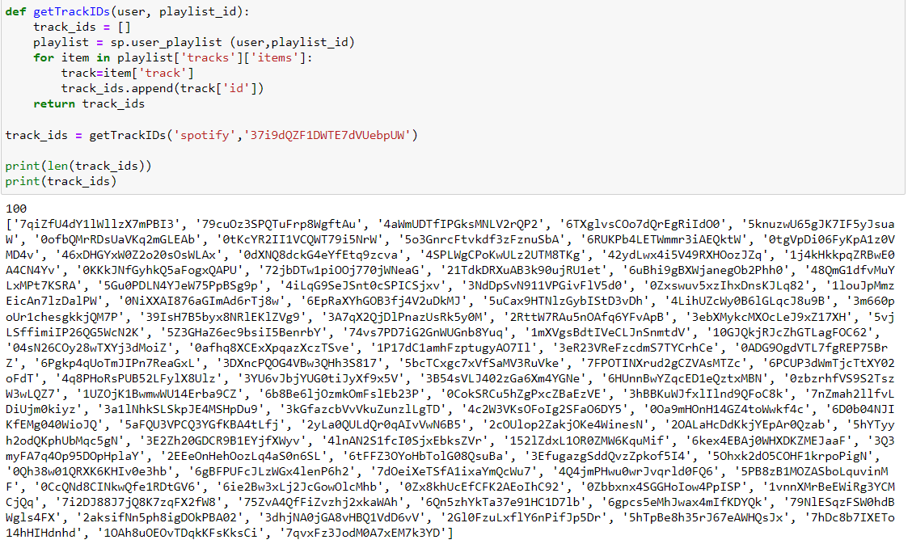
PULLING OUT ONE CSV FILE
Here we crated an array of track ids for each playlist
The playlist id for each request from the API server
the amount of the tracks that are in the playlist and their ids

Slide 6
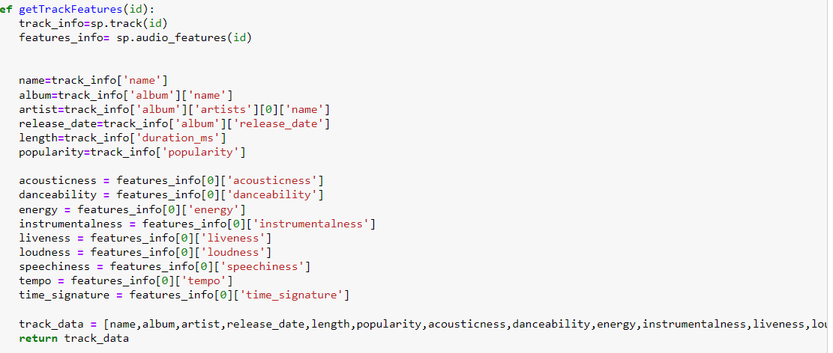
Here we are
getting for each and each song his features
(we will explain every feature meaning in the next slides )

Slide 7

FEATURES EXPLAINED

Slide 8
….
acousticness A confidence measure from 0.0 to 1.0 of whether the track is acoustic. 1.0 represents high confidence the track is acoustic.
danceability Danceability describes how suitable a track is for dancing based on a combination of musical elements including tempo, rhythm stability, beat strength, and overall regularity. A value of 0.0 is least danceable and 1.0 is most danceable.
Energy Energy is a measure from 0.0 to 1.0 and represents a perceptual measure of intensity and activity. Typically, energetic tracks feel fast, loud, and noisy. For example, death metal has high energy, while a Bach prelude scores low on the scale. Perceptual features contributing to this attribute include dynamic range, perceived loudness, timbre, onset rate, and general entropy
Instrumentalness Predicts whether a track contains no vocals. "Ooh" and "aah" sounds are treated as instrumental in this context. Rap or spoken word tracks are clearly "vocal". The closer the instrumentalness value is to 1.0, the greater likelihood the track contains no vocal content. Values above 0.5 are intended to represent instrumental tracks, but confidence is higher as the value approaches 1.0.

Slide 9
Key The key the track is in. Integers map to pitches using standard Pitch Class notation. E.g. 0 = C, 1 = C♯/D♭, 2 = D, and so on. If no key was detected, the value is -1.
Liveness Detects the presence of an audience in the recording. Higher liveness values represent an increased probability that the track was performed live. A value above 0.8 provides strong likelihood that the track is live.
Loudness The overall loudness of a track in decibels (dB). Loudness values are averaged across the entire track and are useful for comparing relative loudness of tracks. Loudness is the quality of a sound that is the primary psychological correlate of physical strength (amplitude). Values typically range between -60 and 0 db.
Mode Mode indicates the modality (major or minor) of a track, the type of scale from which its melodic content is derived. Major is represented by 1 and minor is 0.
Speechiness Speechiness detects the presence of spoken words in a track. The more exclusively speech-like the recording (e.g. talk show, audio book, poetry), the closer to 1.0 the attribute value. Values above 0.66 describe tracks that are probably made entirely of spoken words. Values between 0.33 and 0.66 describe tracks that may contain both music and speech, either in sections or layered, including such cases as rap music. Values below 0.33 most likely represent music and other non-speech-like tracks.

Slide 10
Tempo The overall estimated tempo of a track in beats per minute (BPM). In musical terminology, tempo is the speed or pace of a given piece and derives directly from the average beat duration.
time_signature An estimated time signature. The time signature (meter) is a notational convention to specify how many beats are in each bar (or measure). The time signature ranges from 3 to 7 indicating time signatures of "3/4", to "7/4".
Valence A measure from 0.0 to 1.0 describing the musical positiveness conveyed by a track. Tracks with high valence sound more positive (e.g. happy, cheerful, euphoric), while tracks with low valence sound more negative (e.g. sad, depressed, angry).

Slide 11
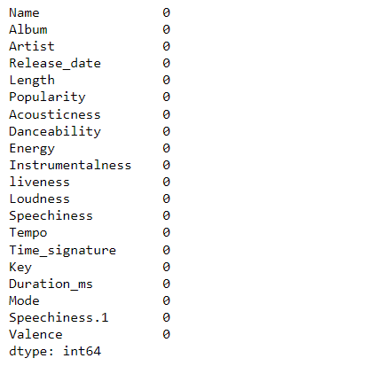
Handling Missing Data
We can see that there are zero NaN values .

Slide 12
EDA
------------------------------------------------------------------------

Slide 13
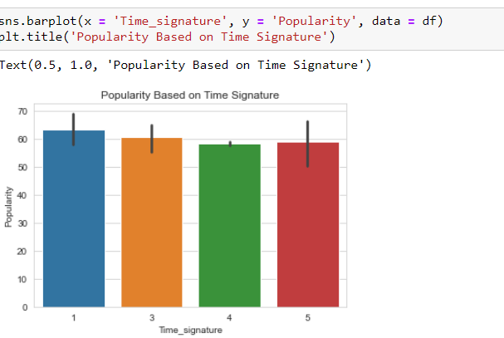
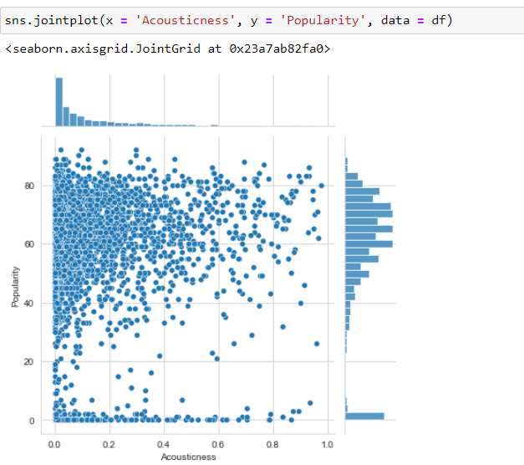
we’ve checked the distribution of all popularity songs based on time signature parameter
We can see that , most of the popular songs in the past 30 years are more likely to be less acoustic

Slide 14
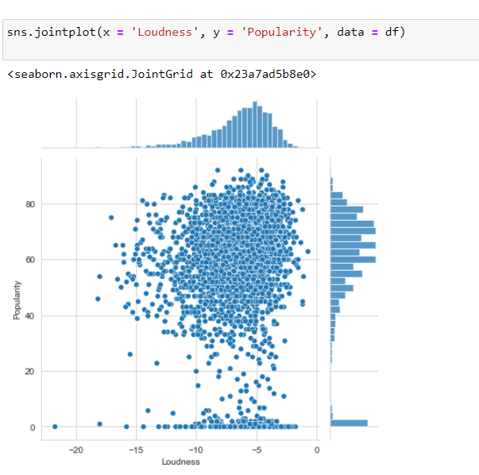
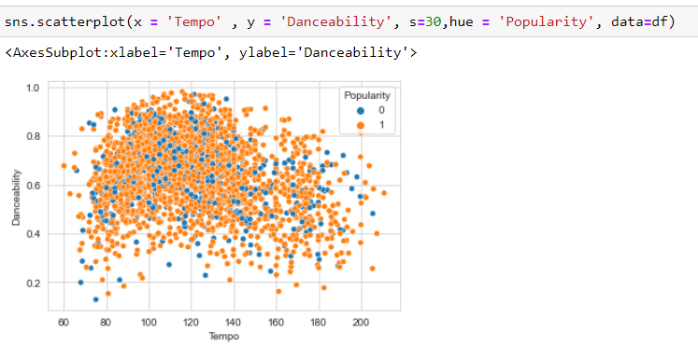
As we noticed at the last slide , that most of the popular song are most likely to be more loudness
Most of the popular songs are more likely to be danceability with tempo value in between 90-125
( that’s avg value of human's heartbeat )

Slide 15
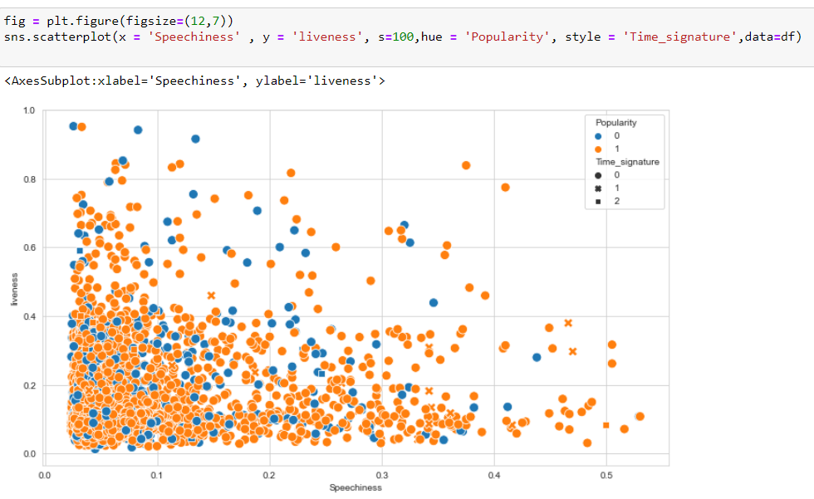
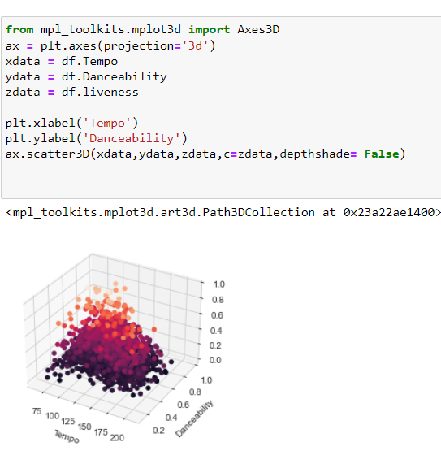
Speechiness among liveness
Tempo with danceability and liveness

Slide 16
WHAT WE’VE FOUND
Most of popular songs are with 1\4 time signature , even though there isn’t much of difference among other values
Most of the popular songs in the past 30 years are more likely to be less acoustic according to the graph .
And of course, As we noticed , Most of the popular songs are most likely to be more loudness
The average TEMPO is 119 BPM
Songs with high danceability and around 119 bpm is more likely to be liveness

Slide 17
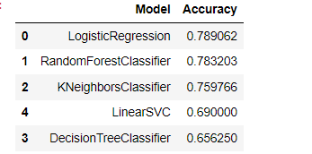
MACHINE LEARNING
We can see that logistic regression gave us the most accurate result .
Even though RFC was very close to be our first choice

